Slide 1
Numerical Simulation of the Lunar Polar Environment:
Implications for Rover Exploration Challenge
NAME:Sushana Islam Mim
ID:22273001
COURSE:CSE717

Slide 2
INTRODUCTION
The text discusses lunar polar region exploration, focusing on illumination conditions, electric-field environment, and potential challenges for rovers. It highlights the unique lighting conditions near the lunar poles, the complex solar wind-induced electric field, and the potential hazards associated with the plasma wake structure within craters. The text also discusses the effects of solar storms on the plasma wake and the characteristics of recursive mini-wakes in lunar polar craters. It emphasizes the importance of water ice and other resources for future human missions.

Slide 3
Purpose of this paper
Analysis of Engineering Constraints
Creation of 3D Model for CE-7's Lunar Rover
Identification of Favorable Traversing and Sampling Sites
Implications for Lunar Polar Region Exploration

Slide 4
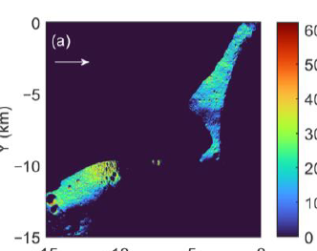
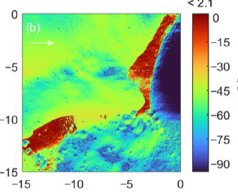
Electric field environment
Rover charging in illuminated areas is relatively homogeneous, while in shadowed areas, the potential varies due to the inhomogeneous electric environment, with the upper side shielded by the de Gerlache crater.

Slide 5
Methodology
Problem Definition and Research Objectives
Literature Review
Identify gaps
Data Collection and Analysis
Spacecraft Plasma Interaction Software (SPIS)
Analysis of Results
Implications and Recommendations

Slide 6
Simulation model
We build a three-dimensional six-wheeled solar-powered lunar rover model with a
length of 1.5 m, a width of 1.2 m, and a height of 1.0 m using SPIS (Figure 6).
The couplingresistance between the main body of the lunar rover and the solar array is set to 10 kW,the electrical connection is achieved between the wheels and the body, and the coupling
resistance between the rover and the lunar surface is set to 1 kW. The simulation domain of
the near-surface environment of the rover exploration is set to a region of 40 40 80 m

Slide 7
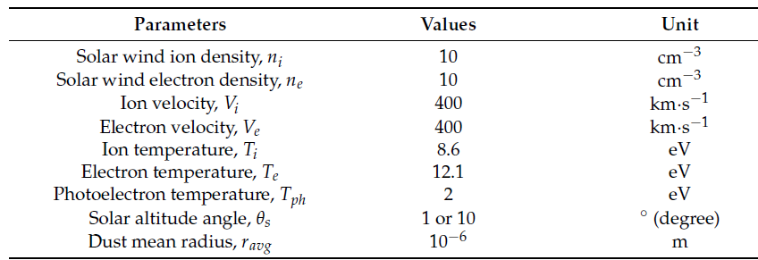
Setup of the Plasma Environment
The Moon's orbit around Earth and the Sun creates complex plasma environments due to solar wind and Earth's magnetic field.

Slide 8
Result
The plasma potential distribution of near-surface space changes with rover traversal around the crater. Positioning the rover in the downwind direction induces higher altitude and lower potential, suggesting a suitable site for lunar polar exploration like CE-7 in the upwind direction, where solar wind minimally impacts charging.

Slide 9
Future plsans
Integration of Real-Time Charging Model
Material Considerations
Terrain Complexity
Optimization of Landing Sites

Slide 10
Conclusion
We found that the complex terrain in terms of
slope affects the local solar altitude angle, which influences the amount of solar energy
received by the rover.
The result showed that the rover can be charged
to different magnitudes when traversing and/or sampling on a flat surface, in a shadow,
and near a meter-scale crater.
We also find that a favorable traversing and/or sampling site
of the rover for future polar exploration is in the upwind direction of a bulge and crater
which has a minimum charging effect.

